Slide 1
Camel & Chicken
Ab

Slide 2
Camelid Ab
The Arabian camel (Camelus dromedarius) and the Lama glama have three IgG subclasses:
The conventional IgG1 and the non-conventional IgG2 and IgG3.
IgG2 and IgG3 are characterized by the absence of light chains and the consequent lack of CH1 domains.

Slide 3
Camelid Ab cont.
In camel, as the antibody specificity is conferred by a single domain, these VH domains also referred as VHH (nanobody) domains are frequently used in antibody engineering.

Slide 4
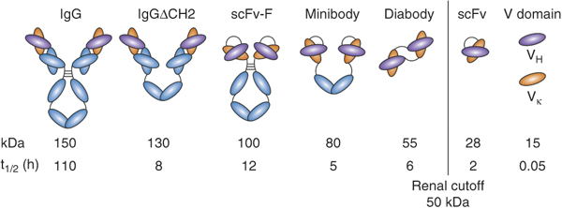
A single-chain variable fragment (scFv) is not actually a fragment of an antibody, but instead is a fusion protein of the variable regions of the heavy (VH) and light chains (VL) of immunoglobulins, connected with
a short linker.

Slide 5
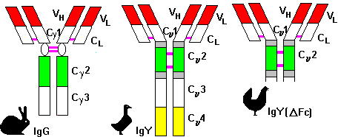
Mammalian IgG &Chicken IgY

Slide 6
IgY AFFINITY AND STABILITY
AFFINITY: IgY has a high affinity for mammalian proteins.
IgY is stable and most antibody activity remain after 15 min at 70 °C
IgY at pH above 4 is well tolerate, but at pH 2 and 37 ºC the activity is rapidly decreased.
The immunological activity of IgY is not affected by pasteurization at 60 ºC for 3.5 minutes.
IgY is stable after A) 5 years at 37 ºC
B) 6 months at RT
C) at least 3 times thawing –freezing

Slide 7
Complementarity determining region
(CDRs)
In the amino acid sequence of a variable domain of an antigen receptor there are three CDRs (Complementarity-determining regions) (CDR1, CDR2 and CDR3), arranged non-sequentially. Since the antigen receptors are typically composed of two variable domains (on two different polypeptide chains, heavy and light chain), there are six CDRs for each antigen receptor that can collectively come into contact with the antigen. A single antibody molecule has two antigen receptors and therefore contains twelve CDRs.
Sixty CDRs can be found on a pentameric IgM molecule.
Sketch of an antibody with the variable domains shown in blue, and the CDRs (which are part of the variable domains)
in light blue

Slide 8
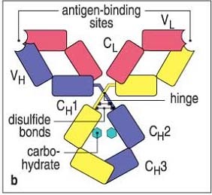
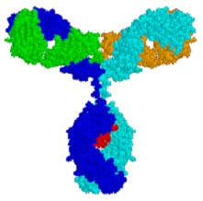
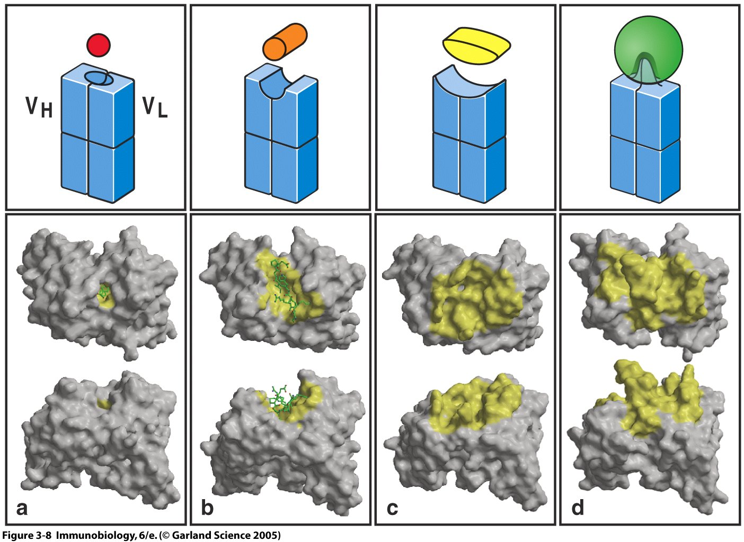
The antigen binding site is made-up of both heavy and light chain CDRs
Antigen [only the part of the antigen that fills the binding site is shown. The antigen can be much much bigger such that only a small part of the whole antigen is in contact with the antigen binding site (see next slides)]

Slide 9
Epitope = antigenic determinant
Antibodies contact epitopes or antigenic determinants
This antigen is a peptide or other small* molecule. Since it fills the antigen binding site, it is also an epitope
*The epitope is small (~6 amino acids or ~6 sugars) or a small part of a larger antigen

Slide 10
Epitope = antigenic determinant
Antibodies contact epitopes or antigenic determinants
Peptides, and other small molecules, will usually not induce an immune response. Thus, although the antibody recognizes and binds a small part of a big molecule, the isolated small part of the molecule cannot induce an immune response.
This antigen is a protein.
An antigen is the whole molecule (or cell) bound by the antibody. Also, the antigen could be an isolated epitope. Immunogens induce immune response and are the target of the induced response (i.e., bound by antibody). Immunogens are antigens but not all antigens are immunogens.
This part of the protein is the epitope for this antibody.
*The epitope is small (~6 amino acids or ~6 sugars) or a small part of a larger antigen.

Slide 11
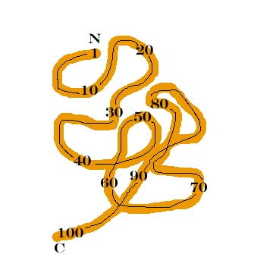
Epitopes are conformational (aka discontinuous) or continuous (aka linear)
This antibody binds aa 81-87; it binds a continuous epitope
This antibody binds aa 34-40; it binds a continuous epitope
This antibody binds aa 71-73 and 85-88; it binds a conformational epitope
This antibody binds aa 95-98 and 61-64; it binds a conformational epitope
TCRs bind only continuous epitopes.

Slide 12
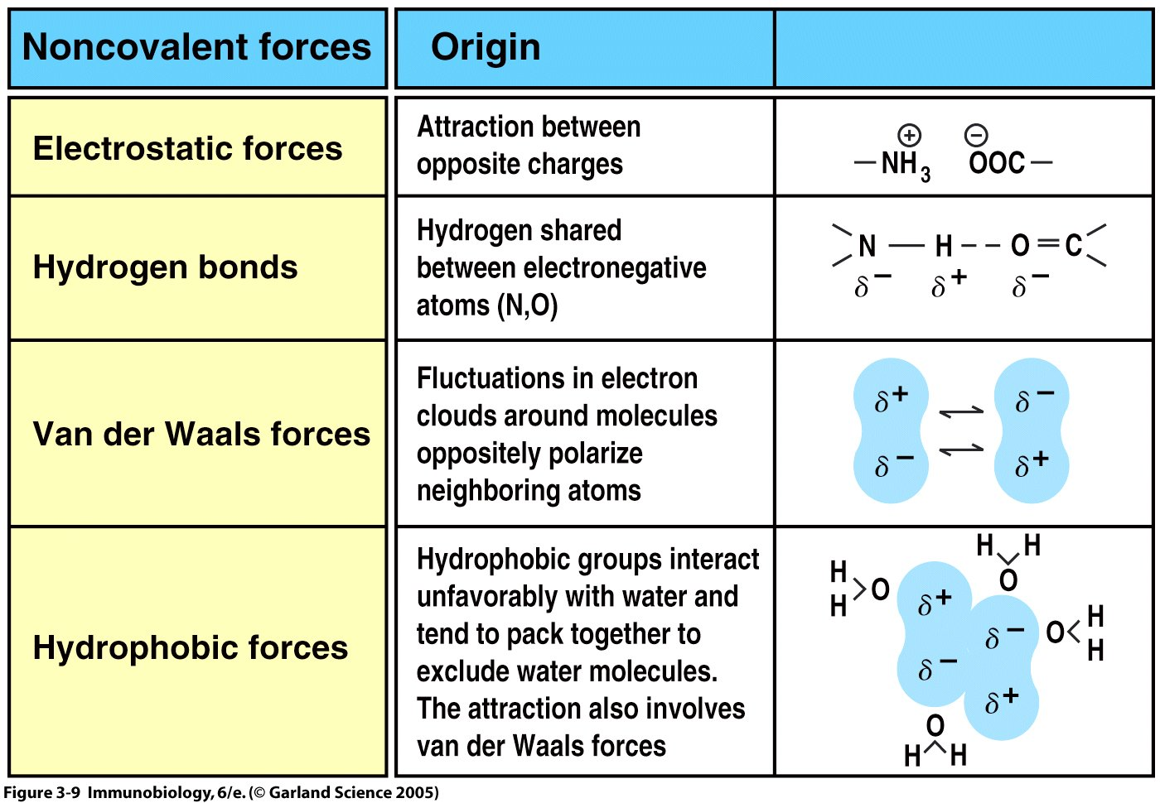
Antigen-antibody complexes are held together by non-covalent forces (therefore, antigen binding by antibody is reversible)

Slide 13
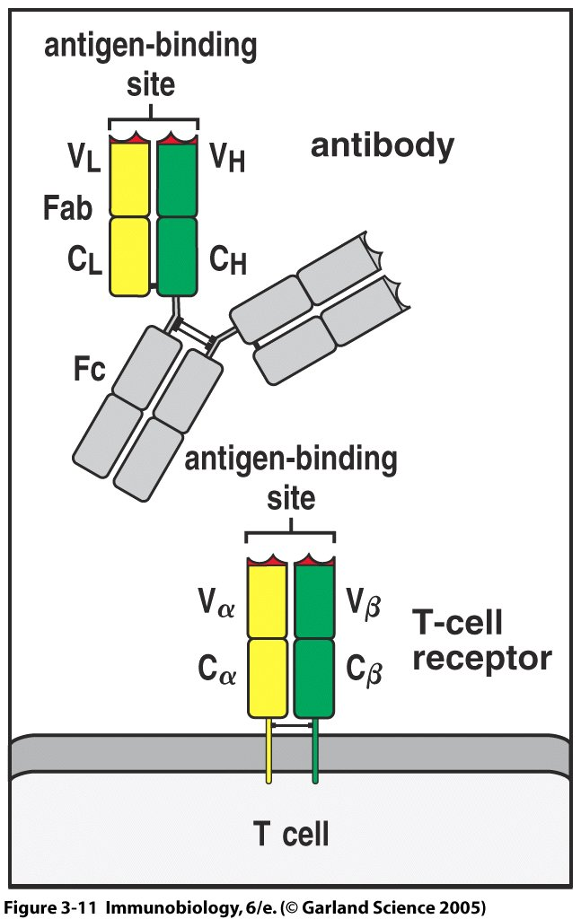
Antigen recognition by the TCR
BCR or membrane Ig or surface Ig
(soluble)
Note the transmembrane and cytoplasmic amino acids here but they are absent on the soluble forms of Igs
B cell

Slide 14
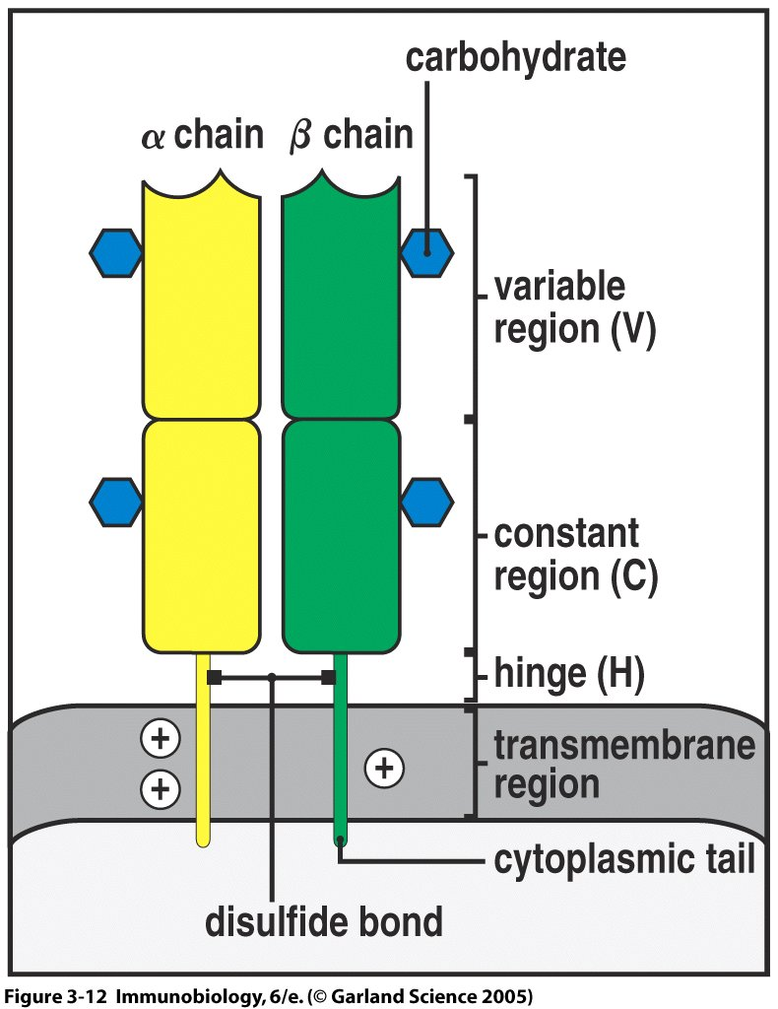
The TCR cont.
There is also a TCR made of a γ and δ chain (the γδ are TCR1)
TCR1 first produced in body (intestine)
The αβ are TCR2
While 90% of TCRs in body are TCR2 which are produced in thymus.
Memory T Cells possessing TCR2

Slide 15
Antibodies, unlike TCRs, bind continuous (linear) or conformational epitopes
Usually antigens recognized by antibodies are in their native configuration. Antibodies bind on the surface of the antigen (e.g., amino acids that are buried in the center of a globular protein are not accessible by antibodies). Antibodies bind linear and conformational epitopes.
Antibodies can bind proteins, carbohydrates, lipids and nucleic acids (essentially any macromolecule), most antibodies bind proteins or carbohydrates.

Slide 16
Unlike antibodies, the TCR binds only continuous (linear) epitopes
The TCR binds peptides from processed protein (proteins that have been chopped-up). Accordingly, TCRs can bind peptides that are derived from the surface of a proteins or peptides from the interior of the protein.
Because of processing and presentation of peptides, the TCR binds only linear epitopes. TCRs can bind non-surface epitopes buried in the center of a big protein and can bind peptides from proteins from inside of bacteria and viruses. TCRs bind only peptides [not nucleic acids, not lipids and not carbohydrates (rare exceptions)] because MHC presents only peptides (not nucleic acids, not lipids, not carbohydrates).

Slide 17
Two classes of T cells are distinguished by surface proteins CD4 and CD8 (surface molecules used to ID cells are called markers)
CD4 cells are assumed* to be T cells (T_{H}) with TCRs that bind antigen (peptide) of MHC class II
CD8 cells are T cells (TCL) that bind antigen (peptide) of MHC class I
Since either CD4 or CD8 binding to MHC is required for the TCR to effectively bind to MHC plus peptide, CD4 and CD8 are TCR co-receptors. CD4 and CD8 also play an important role in signal transduction.
* There are CD4⁺ cells that are not T cells, so be careful

Slide 18
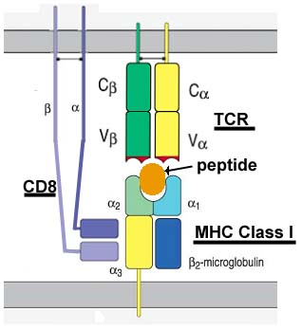
CD8 interacting with MHC class I
T cell (CTL)
membrane
CD8 is mostly heterodimer (α β) and rarely (α α ) homodimer
membrane
Any cell

Slide 19
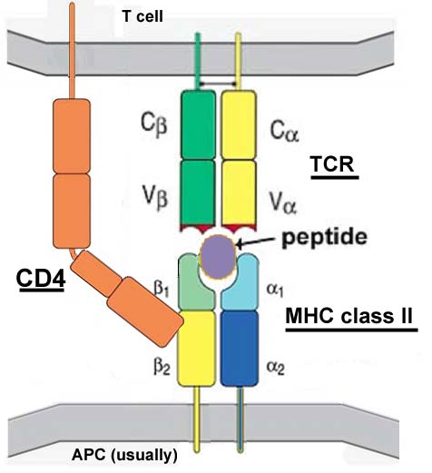
CD4 interacting with MHC class II
membrane
Interactions between CD4 and MHC class II & CD8 and MHC class I are non-covalent.
membrane

Slide 20
Poly- and Mono- Clonal Antibodies
The production of antibodies is an important process in the use of immunoassays because it is the antibody-antigen complexes that form the device uses for its results. Antibodies can be called monoclonal or polyclonal, depending upon the technique used to produce them.
Polyclonal antibody
Antigens possess multiple epitopes
Serum antibodies are heterogeneous,
To increase immune protection in vivo
Monoclonal antibody
Derived from a single clone, specific for a single epitope
For most research, diagnostic, and therapeutic purposes

Slide 21
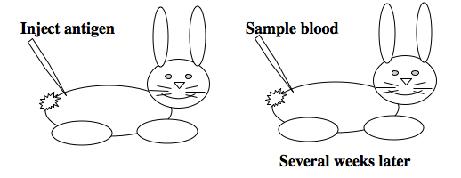
Production of Antibodies Cont’d
Polyconal antibodies are more likely to produce a false positive because they are less specific to antigen epitopes and have varying binding affinities; they may bind of molecules similar to their antigens. Production includes these steps:
A mouse (or rabbit) is immunized by being injected with an antigen; the antigen generates an antibody response in the animal.
The animal is bled and the antibodies are collected; the blood contains a heterogenous mixture of antibodies of varying binding affinities and specificities. (Wild)

Slide 22
Immunization Protocol
Short Term
Long Term
resistance

Slide 23
Production of Antibodies
Monoclonal antibodies involve these basic steps and result in very specific antibodies that bind only to one antigen epitope, which in turn reduces the occurrence of false positives in the immunoassay:
A mouse (or rabbit) is immunized by being injected with an antigen; the antigen generates an antibody response in the animal.
The mouse is sacrificed and the antibody forming cells are isolated from the mouse's spleen.
Monoclonal antibodies are produced by fusing single antibody-forming cells with myeloma cells. The resulting cell is called a hybridoma. This hybridization makes the cells “immortal.”
The hybridomas contain large amounts of antibodies, and can easily be cultured into populations of cells that contain identical antibodies. These antibodies are called "monoclonal antibodies" because they are produced by the identical offspring of a single, cloned antibody producing cell.

Slide 24
HYBRIDOMAS TO MAKE MONOCLONAL ANTIBODIES
LYMPHOCYTE
HYBRIDOMA
MYELOMA

Slide 25
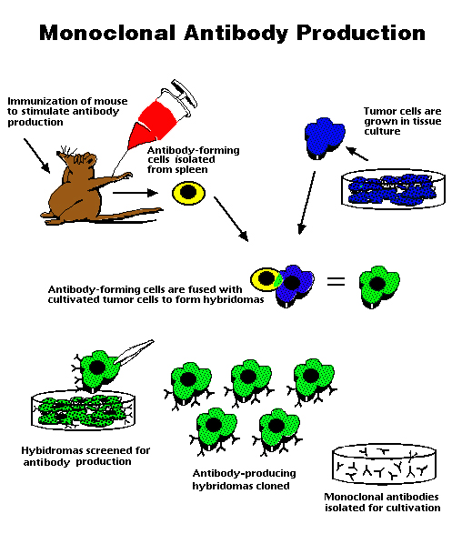

Slide 26
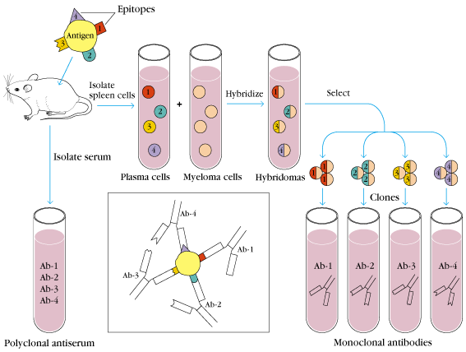
1975, by Georges Köhler and Cesar Milstein
- Be awarded a Nobel Prize in1984

Slide 27
Formation and Selection of Hybrid Cells
Hybridoma: the B cell X myeloma cell
To be produced using polyethylene glycol (PEG) to fuse cells or DMSO
The myeloma cells: immortal growth properties
The B cells: to contribute the genetic information for synthesis of specific antibody
Selected using HAT medium (hypoxanthine, aminopterin, and thymidine)
Myeloma cells are unable to grow
B cells are able to survive, but can not live for extended periods

Slide 28
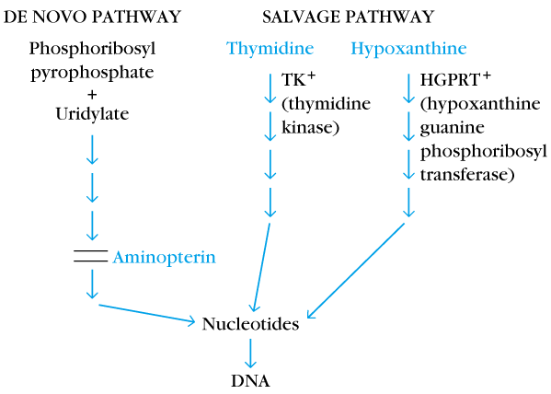
Two different pathways to synthesis nucleotide in mammalian cells
(Folic acid analog)
Myeloma cells used in hybridoma technology are double mutants, they lack the HGPRTase and lose the ability to produce Ig

Slide 29
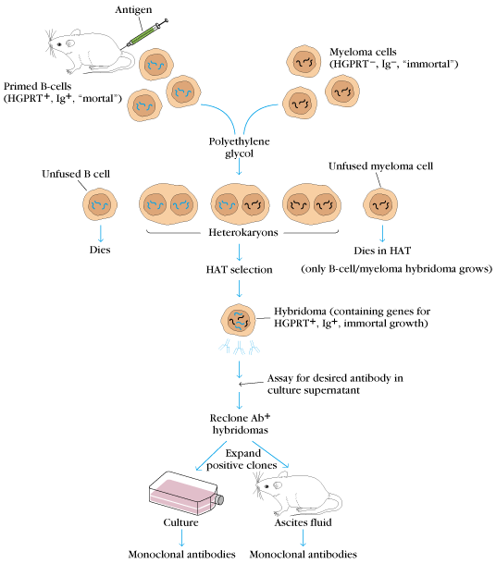
(Most common screening techniques are ELISA and RIA)
Low concentration
(1-20 ug/ml)
High concentration
(1-10 mg/ml)

Slide 30
Spleen
Lymphocytes
+
SP2/0
PEG
Unfused Lymphocytes
Heterokaryons
Unfused SP2/0 Cells
HAT medium
Die in Culture
Hybridomas

Slide 31
Human Monoclonal Antibodies
Production of human monoclonal antibody
There are numbers of technical difficulties
The lack of human myeloma cells to exhibit immortal growth, be susceptible to HAT selection, to not secrete antibody, and support antibody production in the hybridoma made with them
Human B cell sometimes have immortality
That is the difficulty of readily obtaining antigen-activated B cells

Slide 32
Clinical Uses for Monoclonal Antibodies
Very useful as diagnostic, imaging, and therapeutic reagents in clinical medicine
Monoclonal antibodies were used primarily as in vitro diagnostic reagents
Radiolabeled monoclonal antibodies can also be used in vivo detecting or locating
Immunotoxins
To combine of tumor-specific monoclonal antibodies coupled to lethal toxin
Valuable therapeutic reagent

Slide 33
